Slide 1
Welcome to Marketing Operations Open Office Hours – July Session

Slide 2
Agenda
Outreach calendar: Avoid audience overlap – Shivasagar Biradar
Process update: Contact uploads – Srujana Pavuluri
Q&A

Slide 3

Marketing Operations Open Office Hours
Get your questions answered by the marketing operations team. Open Office Hours are held monthly with the following agenda:
Learn about a tip or best practice
Ask a question – Pre-submit your questions here or ask during the office hours
Learn how to leverage IQVIA’s marketing systems and processes most effectively
Action: Sign up here, if you need to be added to the outlook invite
Reminder: Save your questions for the end or enter in the chat. We will address as many as we can!

Slide 4
Outreach Calendar

Slide 5
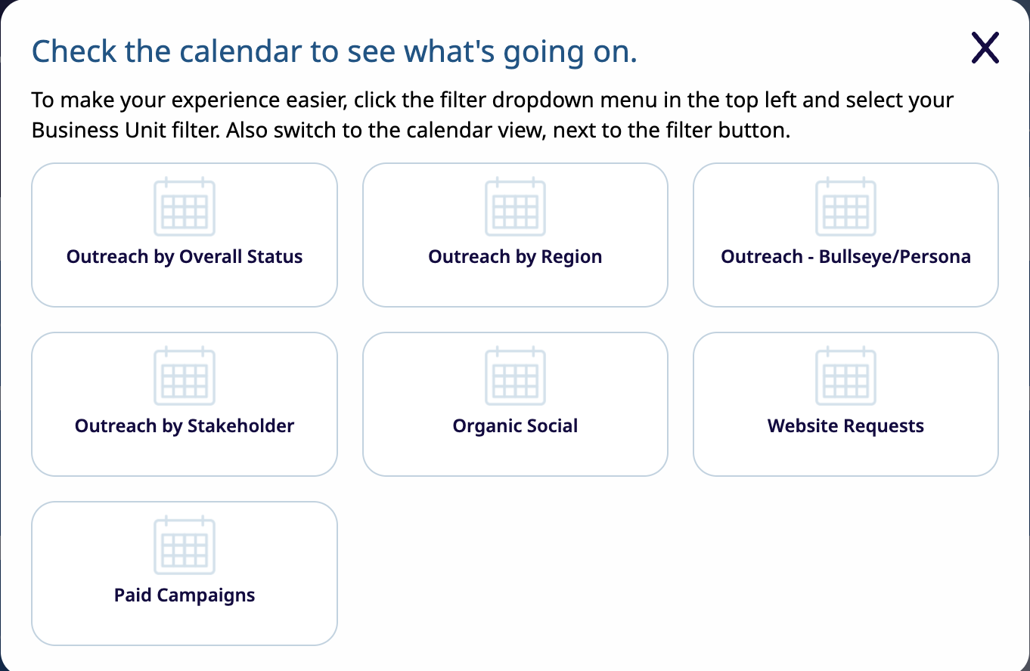
Outreach Calendar
The Outreach Calendar is your go-to tool for planning your campaigns, more strategically. Located in the Resources section of our Toolbox. It helps you identify if other stakeholders are targeting the same persona or bullseye on your planned send date. By adjusting your schedule to avoid overlap, you can increase visibility and drive higher engagement - ultimately improving your campaign metrics.

Slide 6
What all can you monitor
Email Outreach
Outreach by overall status
Outreach by region
Outreach by bullseyes/persona
Outreach by stakeholder
Paid Request
Organic Social
Website Request
You can also access the outreach calendar under the Help section in the Marketing Operations toolbox. If you have any questions or need help with the outreach calendar, reach out to us using the Contact us form
Notes:
Facebook: 1–2 posts per day
Instagram: 1–2 posts per day and 2–4 stories
Twitter (X): 3–4 posts per day
LinkedIn: 1 post per day

Slide 7
Process update: Contact uploads

Slide 8
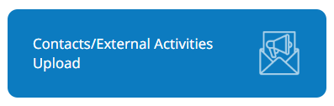
Contact Uploads
Transitioning from Current to New Process
Current Process:
Contact upload requests are handled by both the Activation team and the Feedback, Analytics & Insights team, leading to process inefficiencies and confusion.
Stakeholders frequently submit new contacts as well for segmentation, making it difficult to trace entries and assign accurate lead source details.
New Process:
A centralized intake form will streamline submissions for both Contact Uploads and External Activity Uploads.
The Feedback, Analytics & Insights team will take full ownership of all contact uploads, including those submitted for segmentation.

Slide 9
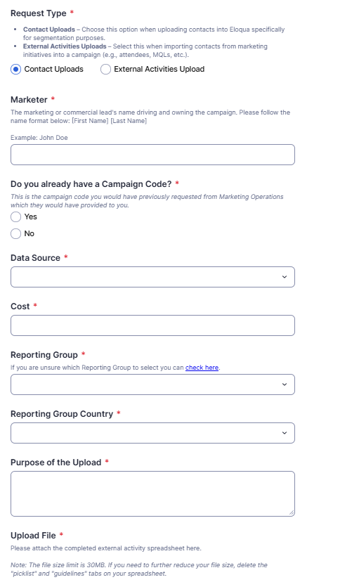
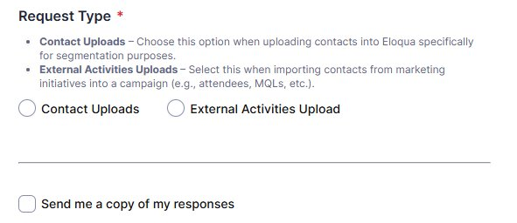
Contacts/External Activities Upload
The form will include an option to specify the type of request - either a Contact Upload or an External Activity Upload.
Depending on the selected request type, relevant fields will dynamically appear.
This form will help standardize the process while capturing key details such as data source, associated costs, and the purpose behind the manual upload.

Slide 10
Marketing Performance Hub Dashboards
Phase 3 Sprint 1 Release
Updates
MQL Performance Page: Introduced the Account field in the "Select Field" slicer
Resources Dashboard: Added new training video links under the Training Links page
New Modules
Channel Dashboard: Included a new field, Ad Type, in the Paid Search Performance table
New Filters
Events and Webinar Page: Added a new slicer for Deliverable Category
New Functions
Paid Social Page: Enabled drill-through on "Total Cost" to display Account Name and Total Spend
New Metrics
Organic Social Page: Introduced a new KPI — Total Click Through Rate calculated as (=Total Click throughs to a URL/Total Impressions). This is different from the Total Click Rate which is calculated as (Total Clicks/Total Impressions).
Feedback, Analytics, and Insights

Slide 11
Thank You

